Slide 1
Unit 6 Lesson 1
History Matters

Slide 2
Opening Work
What are the 6 behaviors that cause the most adverse health and social outcomes for teenagers? Hint: We have control over all of them.
What in one factor that contributes to our health that we have no control over?
What diseases or health conditions have you heard of that have a genetic link?

Slide 3
Six Categories of Risk Behaviors
Six Categories of Risk Behaviors
Behaviors that contribute most to adverse health
and social outcomes…
Behaviors that contribute to unintentional injuries and violence Alcohol and other drug use Sexual behaviors that result in HIV infection, other STDs, and unintended pregnancy Tobacco use Unhealthy dietary behaviors Physical inactivity
…for youth ages 15 to 24 – almost 75% of deaths
…for adults – almost 66% of deaths

Slide 4
Standardized Pedigree Symbols and Relationships
Male
Adopted in
Female
Adopted out
Sex unspecified
Deceased
Monozygotic twins
Divorced
Dizygotic twins
Couple
(horizontal line connects mates)
Offspring
(vertical line connects parents with offspring)
?
Zygosity unknown
Source: Adapted from The Genetics Resource Center, Michigan Department of Community Health, Genomics and Genetic Disorders Section,
www.migeneticsconnection.org

Slide 5
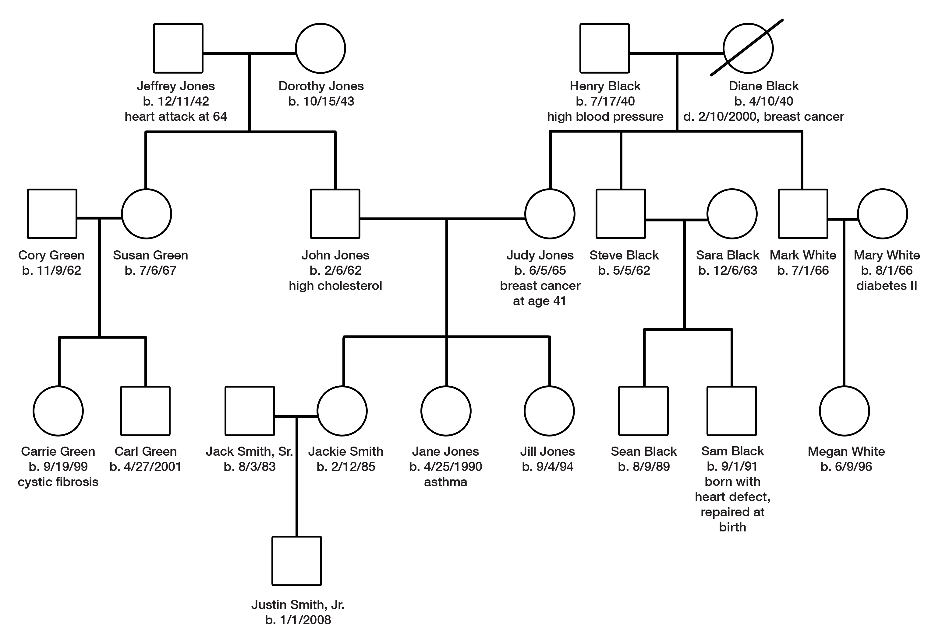
Sample Pedigree
Source: Taken from The Genetics Resource Center, Michigan Department of Community Health, Genomics and Genetic Disorders Section, www.migeneticsconnection.org

Slide 6
Creating your pedigree
US Department of Health and Human Services has a good website that makes it simple to create a pedigree
https: //familyhistory.hhs.gov
or
- Handout “Creating My Family Health Tree”

Slide 7
Homework
Using the worksheet: “Info Exchange: My Family Health History” talk to your family members and other trusted adults about the medical and health information they have about themselves and others in the family
What do you think you should do with your family health tree when finished??

Slide 8
Survey
Complete the Survey provided.

