Slide 1
Unit 3 Lesson 6
Guidelines for Physical Activity

Slide 2
Opening Work
Be prepared to report back on the nutrients you researched.
Name one fact about your nutrient
What foods provide your nutrient
What does the nutrient does for the body.
Potassium
Dietary fiber
Calcium
Vitamin D
Folic Acid
Iron

Slide 3
How Much Is Enough?
Recommendation for People 6-17 Years of Age
60 minutes of moderate- or vigorous- intensity aerobic activity each day
vigorous-intensity activity at least 3 days a week
muscle-strengthening activities 3 days a week
bone-strengthening activities 3 days a week

Slide 4
How Much Is Enough?
Aerobic Activities
you breathe harder
your heart beats faster
Moderate-Intensity Activities = you can talk while you do them, but you can’t sing
Vigorous-Intensity Activities = you can only say a few words without stopping to catch your breath

Slide 5
How Much Is Enough?
Aerobic activities increase cardiorespiratory fitness.
Examples
Running Hopping Skipping Jumping rope Swimming Dancing Bicycling Hiking Skateboarding Rollerblading | Karate Ice or field hockey Basketball Tennis Cross-country skiing Canoeing or kayaking Brisk walking | Games that require catching and throwing, such as baseball and softball Housework and yard work, such as sweeping or pushing a lawn mower

Slide 6
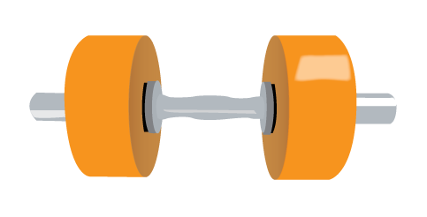
How Much Is Enough?
Muscle-Strengthening Activities
make your muscles stronger
Examples
Push-ups or pull-ups
Lifting weights
Weight machine
Resistance exercises using body weight or exercise bands
Climbing wall
Sit-ups (curl-ups or crunches)
It is important to work all the different parts of the body.

Slide 7
How Much Is Enough?
Bone-Strengthening Activities
produce a force on the bones that promotes bone growth and strength.
Examples
Running
Jumping rope
Basketball
Tennis
Volleyball
Gymnastics
Especially important for children and adolescents
During the teenage years, a person’s growing bones absorb more calcium from the blood than at any other time of life. By early adulthood, a person’s bones stop accepting deposits of calcium.

Slide 8
Activity
Complete “Agree or Disagree” Worksheet.
What motivates or influences people to be physically active?? (make a list)
In groups of 3 or 4 take one of these motivators and create a commercial or advertisement to “sell” physical activity to your peers. Your commercial must contain accurate information and be appealing to teens.

Slide 9
Closure
Rate your level of physical activity. 5 you do well and 1 you don’t do well at all.
What might motivate you to change???

