Slide 1
Unit 2 Lesson 6
RELATIONSHIPS: HIKING THE PEAKS AND VALLEYS

Slide 2
Opening Work:
Why do you think I would use the phrase “peaks and valleys of relationships?”
What health skills are likely to help us the most when building positive relationships? Explain your answer.

Slide 3
HEALTH SKILLS
HEALTH SKILLS
HEALTH SKILLS
Accessing Information
Effective listening
Responding to the emotions of others
Assertive communication
Questioning
Refusal
Collaboration
Negotiation
Analyzing Influences
Decision Making
Goal Setting
Interpersonal Communication
Self Management
Advocacy

Slide 4
HEALTH SKILLS
HEALTH SKILLS
HEALTH SKILLS
Accessing Information
Accurately assess personal skills, attributes, and habits
Choose habits that promote health and personal and social responsibility
Assess situations and decide on healthy choices
Know and use strategies to avoid injury
Manage and express emotions constructively, including anger
Know and use strategies to manage stress
Analyzing Influences
Decision Making
Goal Setting
Interpersonal Communication
Self Management
Advocacy

Slide 5
NEGOTIATION
Ask
Effective Questions
Refusal
Respond to Emotions
Assertive Communication
NEGOTIATION
NEGOTIATION
Negotiation: a combination of stating your ideas and opinions assertively, responding to emotions appropriately, asking effective questions, refusing if needed, and listening to others to reach an understanding or resolve a dispute or problem peacefully; conflict resolution
Listening
Decision Making Skills

Slide 6
Conflict Situation
Be calm before you interact with the person or person’s involved.
What strategies have you learned that work for you to de-escalate your emotions?
Conflict…

Slide 7
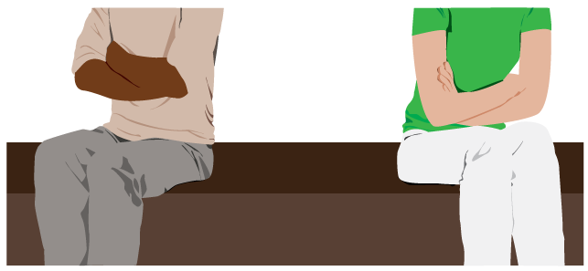
COOLING DOWN A TOUGH SITUATION
Stay calm.
Suggest another time to talk about the issue.
Move away from the person.
Talk slowly and use a calm voice.
Move slowly.
Listen to the person.

Slide 8
PRACTICE FOR MASTERY
Decide which of the individuals you want to imagine being.
Complete your “side” of the conflict resolution or negotiation.
Work with your partner to create a script describing your conversation as you and your partner resolve the conflict.

Slide 9
Closure
How do “peaks and valleys of relationships” relate to our social and emotional health?
Think about your own ability to resolve conflicts. Rate yourself: a rating of 10 means you have outstanding conflict resolution skills, a 5 means you need to spend more time practicing this skill, and a 1 means this is a new skill for you to develop. (share your rating and your reasons with your partner)

Slide 10
Homework:
Bullying and Harassment worksheet
Please research the topics of bullying and harassment and answer the questions on the student worksheet.
You will need to be prepared to share information from your worksheet and turn in your completed research with citations.

