Slide 1
Unit 1 Lesson 9
Collaborative Work on Teaching Tools

Slide 2
Details for Creating a Teaching Tool
Create a teaching tool that explains and demonstrates your assigned skill.
Your presentation will be evaluated on these two criteria:
thorough and accurate explanation
accurate and clear demonstration
You have up to five minutes to present your skill in a small group.
Option: research additional data on the skill and note the source.

Slide 3
Creating and Using Our Teaching Tools
First Small Group: Create a Teaching Tool for One of the Communication Skills
X
Y
Z
X
X
Y
Y
Z
Z
X
X
Y
Y
Z
Z
Listening
Responding
Assertive Communication
Q
W
Q
Q
W
W
Q
Q
W
W
Asking Effective Questions
Refusal

Slide 4
Creating and Using Our Teaching Tools
Second Small Group: Share the Teaching Tool and Learn About Other Communication Skills
X
Q
Z
Y
Q
X
Z
Q
W
W
Z
Y
W
X
Y
W
Y
Z
Y
W
X
Q
X
Z
Q

Slide 5
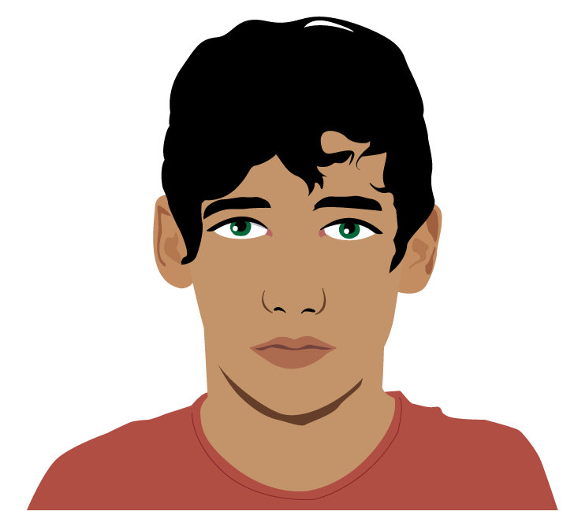
Thoughts on Communication Skills
Which of the five communication skills do you think is the easiest to master and why?
What would you like clarification on?

