Slide 1
Unit 1 Lesson 14
Combining the Five Basic Communication Skills to Effectively Collaborate and Negotiate

Slide 2
COLLABORATION
Ask
Effective Questions
Refusal
Respond to Emotions
Assertive Communication
COLLABORATION
COLLABORATION
Collaboration: working with others to achieve a goal by stating your ideas and opinions assertively, responding to emotions appropriately, asking effective questions, refusing if needed, and listening to others
Listening
Goal Setting Skills

Slide 3
COLLABORATION
Collaboration: working with others to achieve a goal by stating your ideas and opinions assertively, responding to emotions appropriately, asking effective questions, refusing if needed, and listening to others
Goal Setting Skills
COLLABORATION
COLLABORATION
Goal Setting
Develop a clear, realistic goal.
List steps for reaching the goal.
Decide when you will act on the steps.
List any materials you will need.
Name people who can help.
Monitor your progress and make changes if you need to.
Evaluate whether or not the goal was met.
Be sure all of you are working towards the same goal.

Slide 4
NEGOTIATION
Ask
Effective Questions
Refusal
Respond to Emotions
Assertive Communication
NEGOTIATION
NEGOTIATION
Negotiation: a combination of stating your ideas and opinions assertively, responding to emotions appropriately, asking effective questions, refusing if needed, and listening to others to reach an understanding or resolve a dispute or problem peacefully; conflict resolution
Listening
Decision Making Skills

Slide 5
NEGOTIATION
NEGOTIATION
NEGOTIATION
Decision Making | Negotiation
Step 1: Describe the decision or problem. | Does everyone involved in the negotiation describe the problem or issue in the same way? If not, keep sharing ideas and listening.

Slide 6
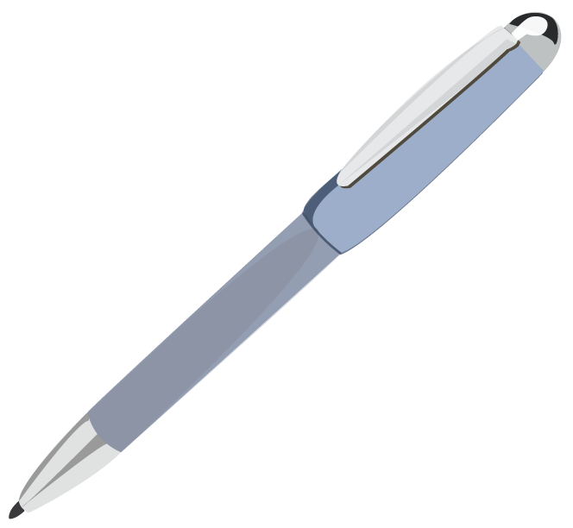
NEGOTIATION
NEGOTIATION
NEGOTIATION
Decision Making | Negotiation
Step 2: Identify what you want to happen. Check your thinking. | If the people you are negotiating with want something different to happen, is there a way to compromise? If not, keep talking and listening.
Check Your Thinking
Do your ideas:
follow your personal and family values?
help you stay safe and healthy?
follow family, school, and community rules?
show respect for myself and others?
seem realistic? Could the idea work?

Slide 7
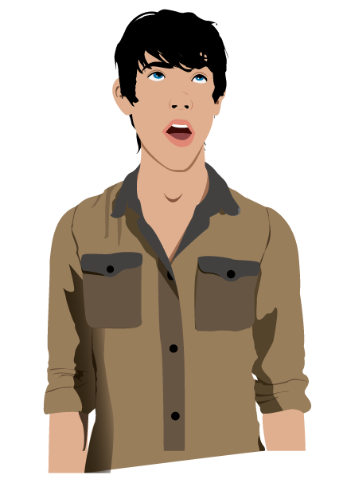
NEGOTIATION
NEGOTIATION
NEGOTIATION
Decision Making | Negotiation
Step 3: Brainstorm optional ways to get what you want to happen. | Try to find ideas that everyone agrees to and that will get you the closest to what everyone wants.

Slide 8
NEGOTIATION
NEGOTIATION
NEGOTIATION
Decision Making | Negotiation
Step 4: Omit ideas that don’t check out and ideas you don’t want to try. Check your thinking. | Each side in the negotiation has veto power over ideas.
Step 5: Select an idea to try. | If you can’t find a mutually agreeable idea, go back to brainstorming (Step 3).
Step 6: Act on the idea. | Identify the actions that need to be taken to implement the idea.
Step 7: Evaluate how it turned out.

Slide 9
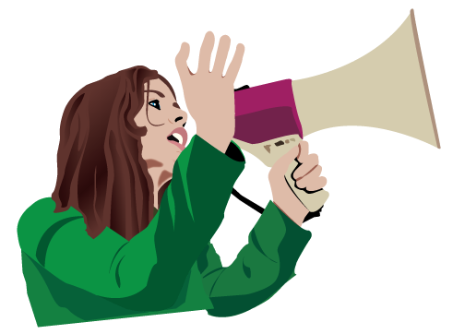
Seven Health Skills
Advocacy
^{Accessing Information}
^{Analyzing Influences}
^{Goal Setting}
^{Decision Making}
^{Interpersonal Communication}
^{Self Management}
^{Advocacy}

Slide 10
ADVOCACY
ADVOCACY
ADVOCACY
Take a clear stand for a healthy choice.
Explain why the stand taken is good for health.
Use information to support the choice.
Show awareness of the audience for the message.
Who do you need to talk with to advocate?
How would we influence them?
Be persuasive.
Show conviction about the message.

Slide 11
Advocacy Project
Divide into groups of 5.
Assign a leader, spokesperson, and recorder
Plan an advocacy project (provide handouts)

Slide 12
Advocacy Topics/ Projects
Advocate for a salad bar in the cafeteria
Advocate for the construction of “complete streets” in the community (streets where there are accommodations for bicyclists, walkers, and automobiles)
Advocate for after school classes on stress management
Advocate for the reduction of bullying in school
Advocate for air conditioning in school
Advocate for year round school
Advocate for an open or closed campus for lunch
Advocate for more physical activity opportunities in the school day
Advocate for more availability of technology in the school
Advocate for mobile phone use in the classroom
Advocate for the formation of a support group in your school

Slide 13
Individual Paper
You will be responsible for an individual paper. Respond to the questions at the bottom of your handout. The individual paper will be completed outside of class and will be due Friday 9/27/2013.

Slide 14
Closure
Raise your hand if you or someone in your group used a communication skill.

Slide 15
Reflection Question
When do you see collaboration and/or negotiation being used among your friends or other peers? What are the benefits?

