Slide 1
Unit 1 Lesson 10
Teaching Communication Skills

Slide 2
^{Interpersonal Communication}
Skills to Respond to the Emotions
of Others
Assertive Communication Skills
Listening Skills
Skills to Ask Questions
Refusal Skills

Slide 3
Creating and Using Our Teaching Tools
First Small Group: Create a Teaching Tool for One of the Communication Skills
X
Y
Z
X
X
Y
Y
Z
Z
X
X
Y
Y
Z
Z
Listening
Responding
Assertive Communication
Q
W
Q
Q
W
W
Q
Q
W
W
Asking Effective Questions
Refusal

Slide 4
Creating and Using Our Teaching Tools
Second Small Group: Share the Teaching Tool and Learn About Other Communication Skills
X
Q
Z
Y
Q
X
Z
Q
W
W
Z
Y
W
X
Y
W
Y
Z
Y
W
X
Q
X
Z
Q

Slide 5
GROUP MEMBERS SHOULD GAIN…
GROUP MEMBERS SHOULD GAIN…
GROUP MEMBERS SHOULD GAIN…
…a thorough and accurate explanation of the skill.
…an accurate and clear demonstration of the skill.

Slide 6
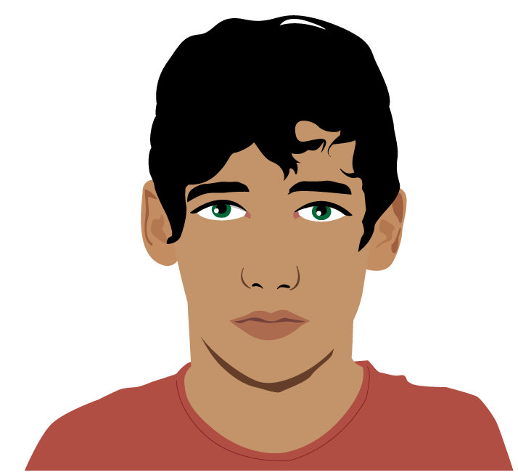
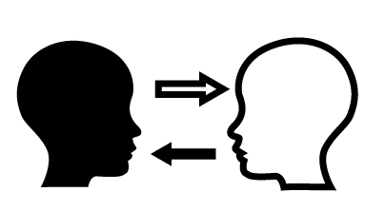
Thoughts on Communication Skills
Which of the five communication skills do you think is the easiest to master and why?
What would you like clarification on?

